Slide 1
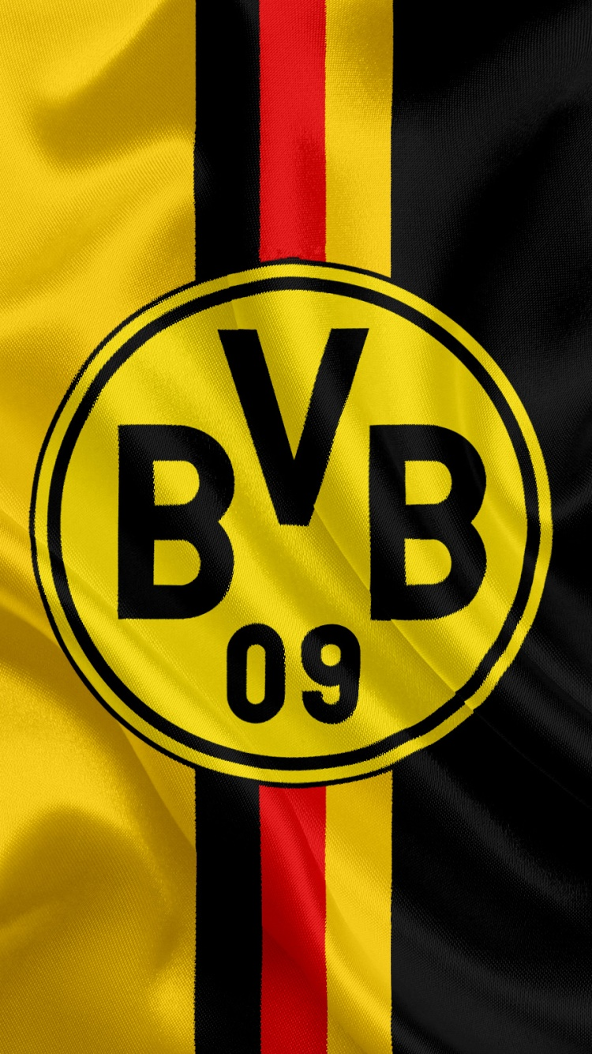
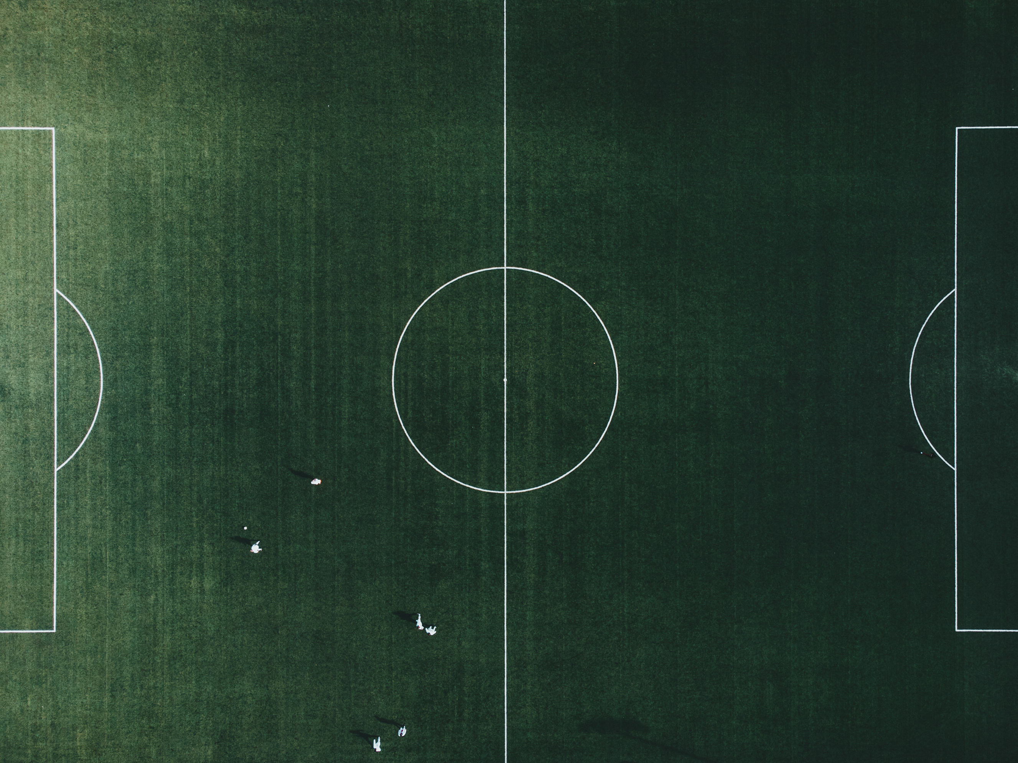
A STRATEGIC ANALYSIS
of
RIGHT-WINGER TARGETS
for
2016/2017 SEASON
Presented by:
Data Analyst –
Trinh Quang Tri
Presented to:
Head Coach - Thomas Tuchel

Slide 2
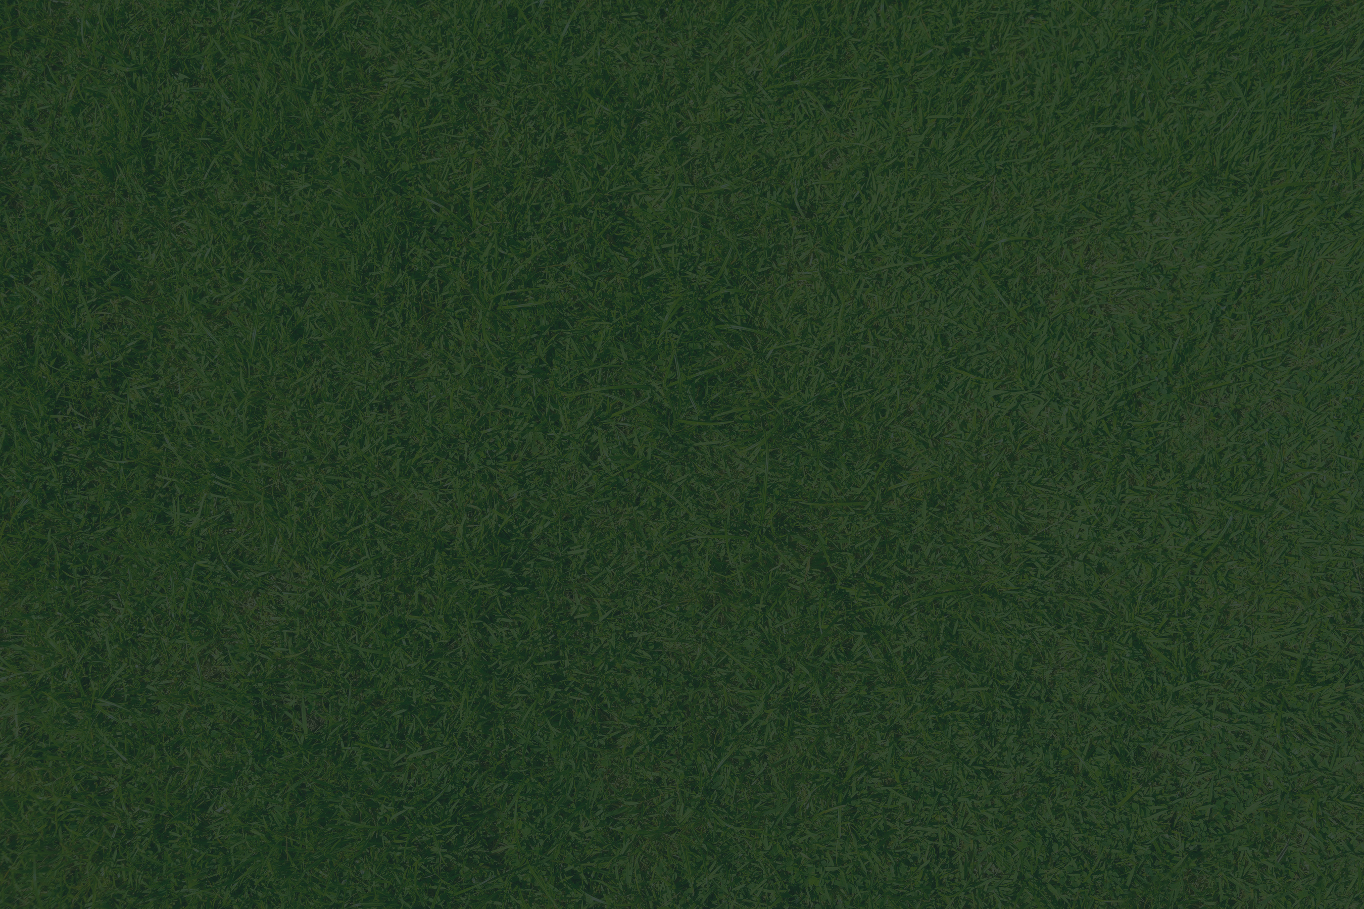
v
Background
The Situation:
Our Philosophy:
Following a record-breaking 82-goal season where we finished a strong 2nd, we face a critical challenge: replacing three core players, including the Bundesliga's top creator, Henrikh Mkhitaryan.
Our tactical identity under Coach Tuchel demands intelligent and technically gifted players who are versatile enough to thrive in a fluid, possession-based attacking system. We don't just recruit talent; we recruit intelligence.
Our Mission:
To use data to identify the optimal Right-Winger who not only fills the creative void left by Mkhitaryan but also possesses the unique tactical profile to elevate our attack for the upcoming season.

Slide 3
1. Market Analysis
2. Target 1: Ousmane Dembélé
Agenda
4. Target 3: Riyad Mahrez
3. Target 2: Hakim Ziyech
5. Final Comparision

Slide 4
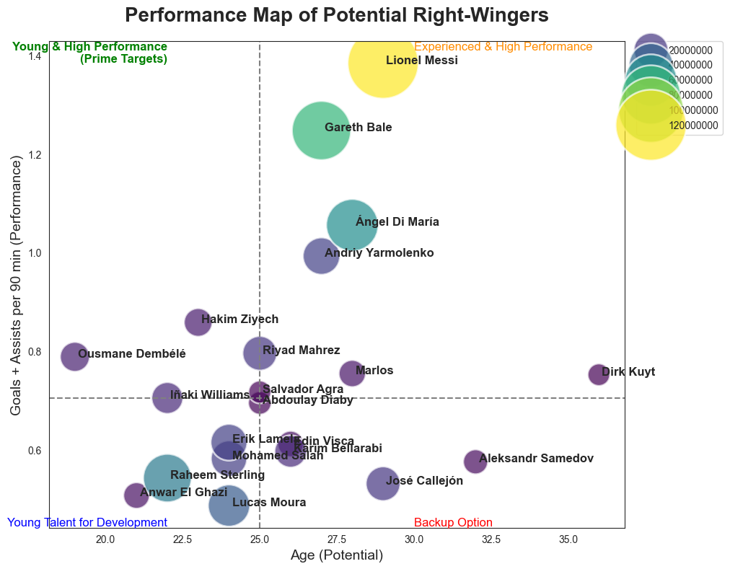
Market Analysis
Strategic Focus: Our focus narrows to the top-left quadrant. This zone contains the most strategically valuable players: those who combine youth (high potential) with elite performance (immediate impact).
The Elite Tier (Top Right): This group is dominated by world-class, unattainable players like Lionel Messi and Gareth Bale. They demonstrate the highest level of performance but are not on the market and are financially out of our reach. They serve as a benchmark for world-class output.
The Veteran Tier (Far Right): Players aged 30+ like Dirk Kuyt and Aleksandr Samedov represent experienced, lower-cost options. However, they do not align with our club's strategy of signing players with long-term potential and resale value.
Our Selected Candidates: Based on this market analysis, we will now proceed with a detailed dossier on the top three candidates from this "Prime Target" zone:
Ousmane Dembélé (The Highest Potential)
Hakim Ziyech (The Top Performer)
Riyad Mahrez(The Proven Premier League Star)
The Attainable Talent Pool (Center & Left): A significant cluster of talented players under the age of 28 exists. This is a rich market for strategic recruitment, and our ideal candidate lies within this group.
The Shortlist: From this zone, a clear shortlist of attainable, high-value players emerges. These players represent the optimal balance of reasonable cost, proven current ability, and significant future growth.

Slide 5
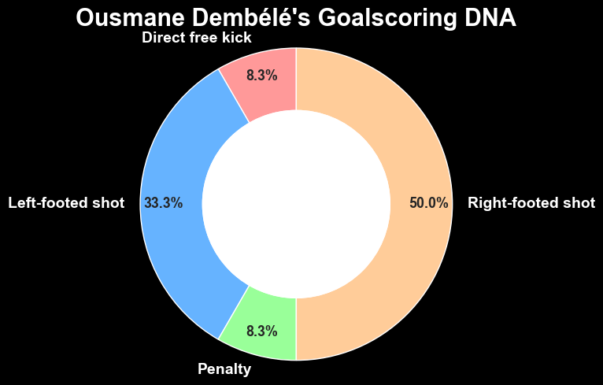
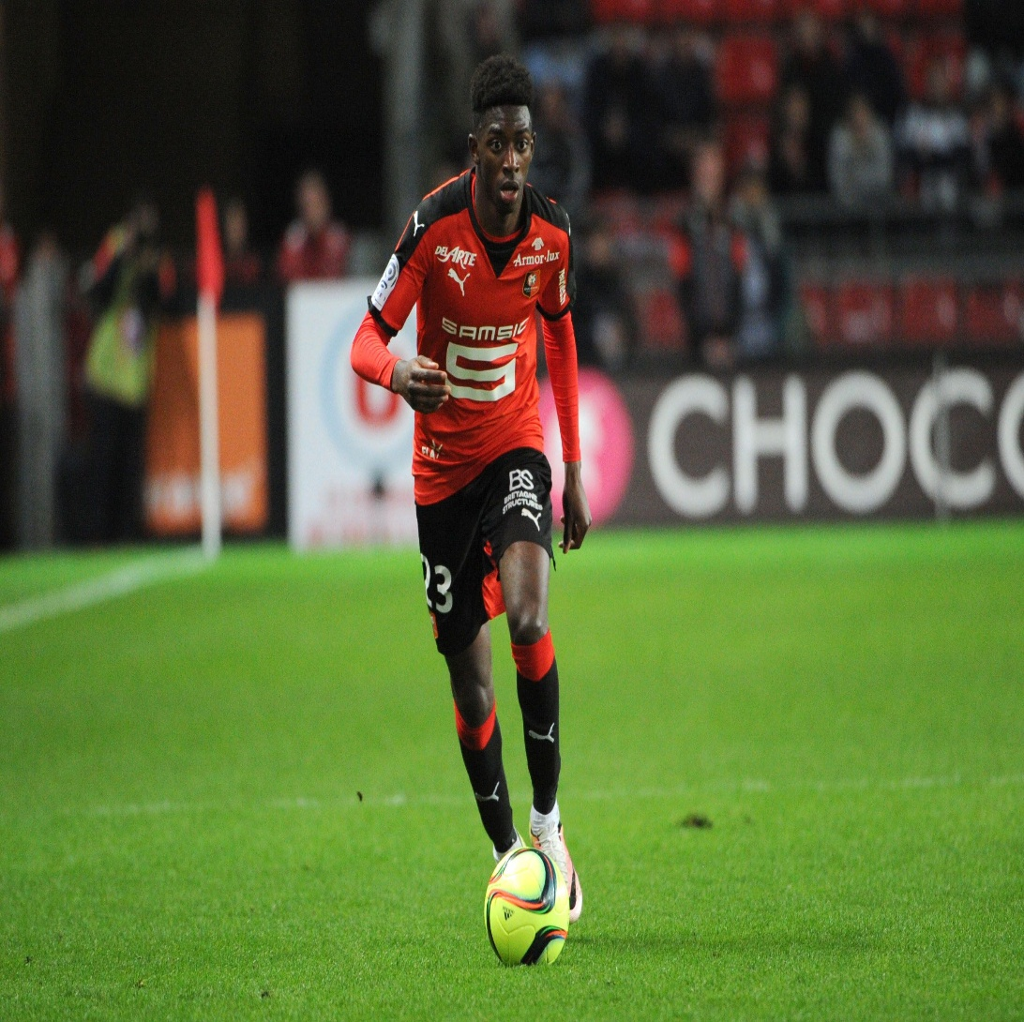
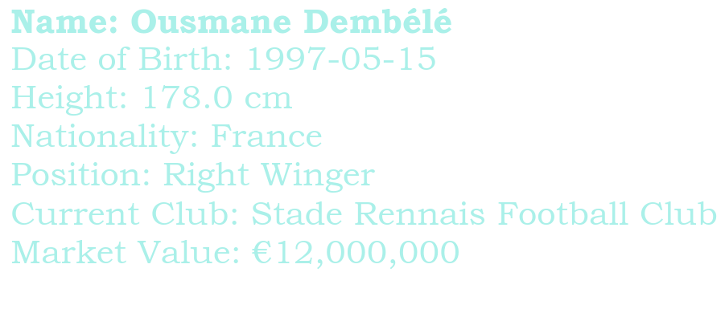

1. Exceptional Two-Footed Ability: The key insight from this chart is Dembélé's rare and elite two-footedness. He scored 50% (6 goals) with his right foot and 33.3% (4 goals) with his left foot. This near-equal distribution is extremely uncommon.
2. Tactical Unpredictability: This two-footedness makes him a massive tactical advantage. Defenders cannot simply show him onto a "weaker" foot. It allows him to be equally dangerous cutting inside from the right wing or driving down the line from the left, which perfectly suits our fluid, interchangeable attacking system.
3. Versatile Goal Threat: In addition to his open-play threat, he also demonstrates the ability to score from direct free kicks and penalties, adding another dimension to his game and proving his technical skill in dead-ball situations.
Target 1

Slide 6
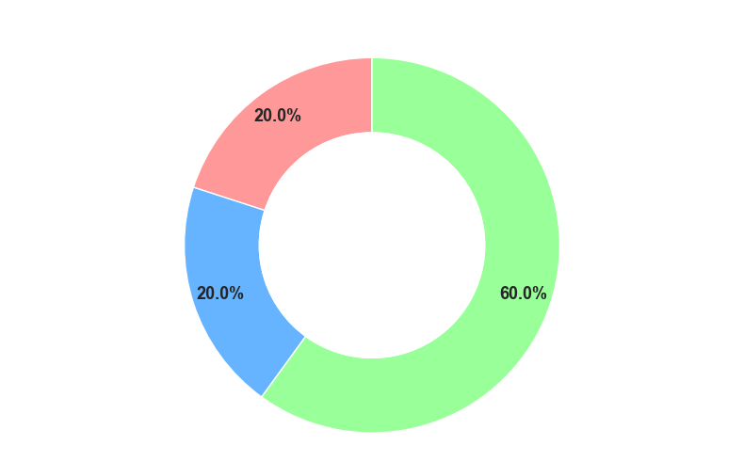
1. Vision in Open Play: The data shows that Dembélé is a highly effective creator during the natural flow of the game. The majority of his assists (60%) come from open-play passes, indicating strong vision, decision-making, and an ability to participate in intricate build-up play.
2. Multi-faceted Creativity: He is not reliant on a single method to create chances. His ability to assist from crosses (20%) and corners (20%) demonstrates his tactical versatility. He can function as both an inverted winger who cuts inside to pass, and a traditional winger who can deliver from wide areas.
3. Complete Attacking Player: This well-rounded creative profile means he can seamlessly integrate into our quick combination play while also providing a reliable threat from set-piece situations.
Target 1

Slide 7
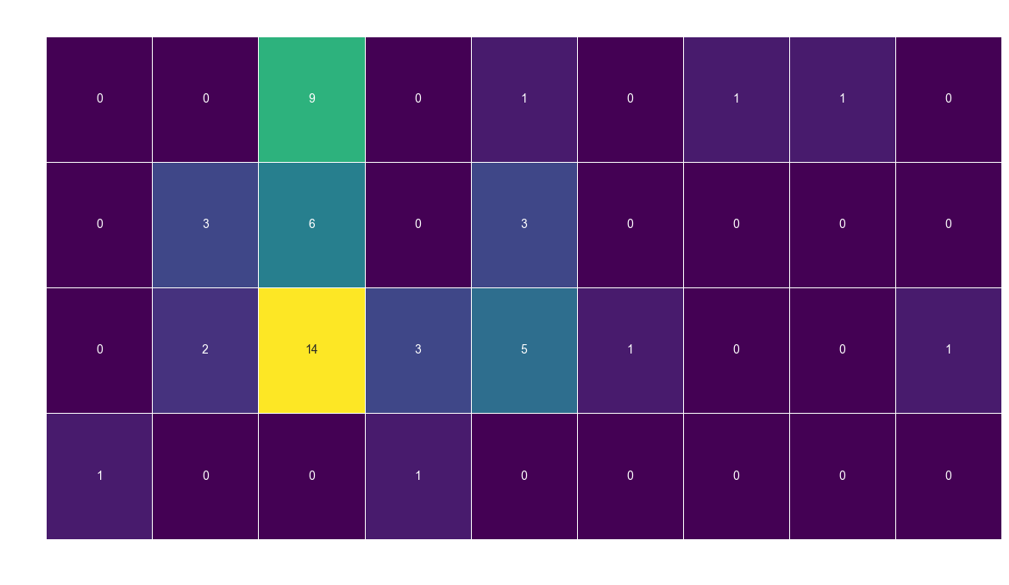
v
1. High Versatility Across the Front Line: The data shows that Dembélé is not confined to a single role. He has significant experience playing as a Right Winger (RW), Left Winger (LW), and Attacking Midfielder (AM). This ability to perform effectively in multiple positions is a rare and valuable asset.
2. Perfect Fit for Our System: His most frequently used position is Right Winger within a 4-2-3-1 formation (14 appearances). This is a direct confirmation that he is comfortable and experienced in the exact role and system that is central to our team's tactics. He also has extensive experience in a 4-3-3, showcasing his adaptability.
3. Proven Performer on Both Flanks: Crucially, Dembélé is not just a right-winger. He has also played numerous games as a Left Winger in both the 4-2-3-1 and 4-3-3 formations. This tactical flexibility would allow for fluid interchanges with Marco Reus during matches, making our attack far more dynamic and difficult to defend against.
Target 1

Slide 8
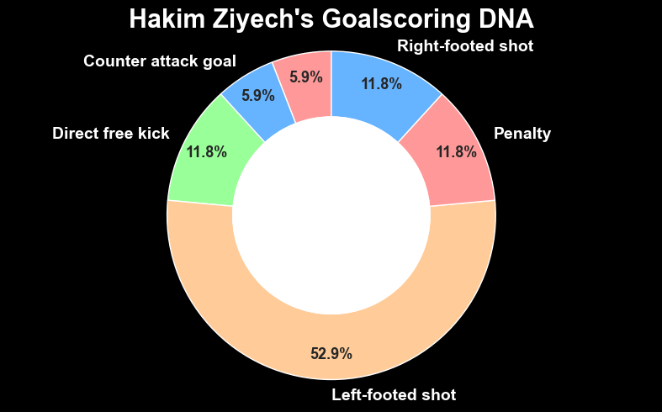
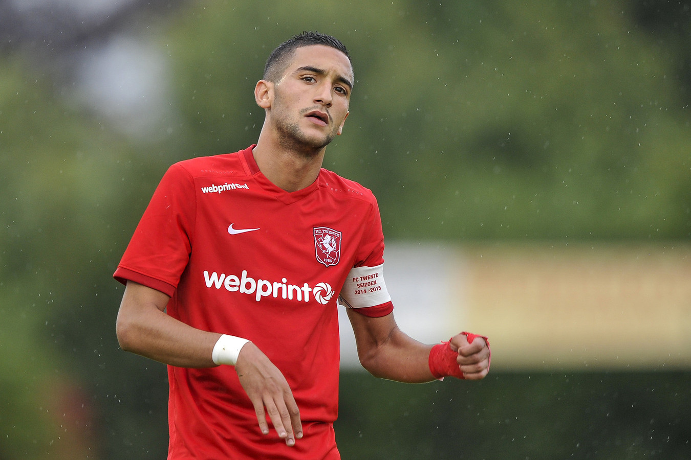
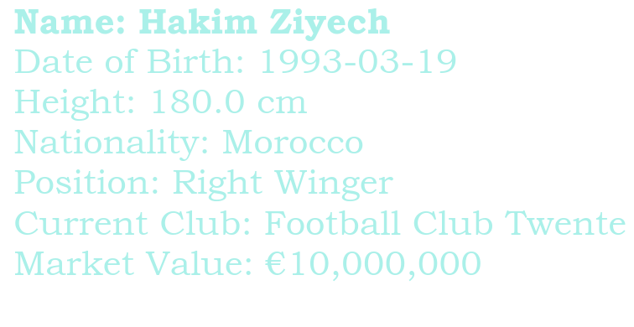
1. A Precise Left-Footed Finisher: The data clearly shows that Ziyech is a specialist who relies on his technical quality. The vast majority of his open-play goals come from his dominant left foot (52.9%).
2. A Master of Set Pieces: A significant portion of his goals come directly from dead-ball situations. His 2 direct free kick goals highlight his ability to be a threat even when the team is not creating chances from open play. This is a valuable skill for breaking down defenses.
3. Predictable Scoring Profile: While effective, his goalscoring is somewhat one-dimensional. The heavy reliance on his left foot and set pieces makes his finishing patterns more predictable for top-tier defenders compared to a two-footed player.
Target 2

Slide 9
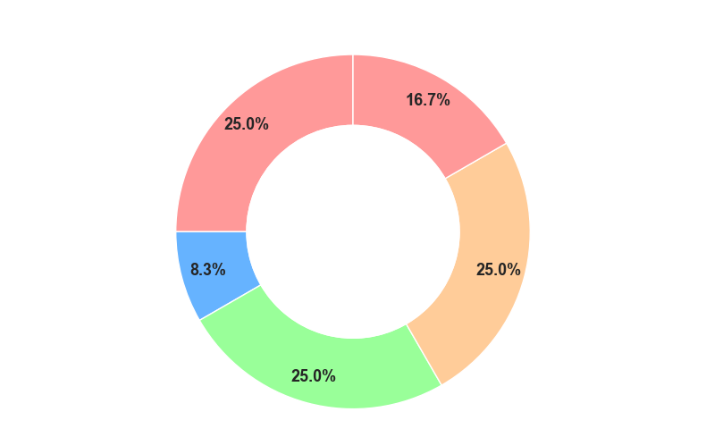
1. World-Class Set-Piece Delivery: This chart reveals Ziyech's most dominant and valuable trait. An incredible 50% of his assists come directly from set-piece situations (25% from Corners, 25% from Free Kicks). This is an elite, game-changing skill.
2. A True Team Playmaker: His assists are not just a product of individual skill but of creating opportunities for others. His ability to deliver from corners, free kicks, open-play passes, and even crosses shows he is the primary creative hub of his team.
3. Guaranteed Chance Creation: Signing Ziyech is a guaranteed way to increase the number of chances created. He provides a constant threat that can unlock defenses, especially in tight matches where a single set piece can make the difference.
Target 2

Slide 10
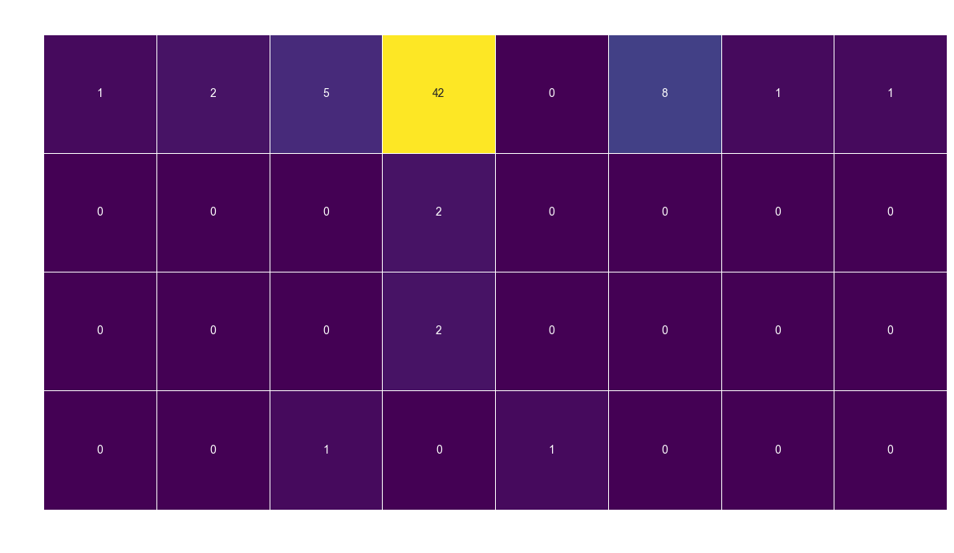
1. A "Number 10" Profile: The tactical data is clear: Ziyech is fundamentally an Attacking Midfielder, not a natural winger. The vast majority of his appearances (over 40) in the 4-3-3 system were in a central creative role.
2. A Different Tactical System: He has extensive experience in a 4-3-3 Defending formation. This suggests he is accustomed to a system that may require more defensive responsibilities from its attackers compared to our high-possession, attacking style.
3. Potential Fit Issues: While he is a phenomenal player, he does not naturally fit the profile of a pure Right-Winger needed to replace Mkhitaryan's role. Signing him would likely require a tactical adjustment, perhaps using him as a "false winger" who drifts inside, rather than a player who provides width.
Target 2

Slide 11
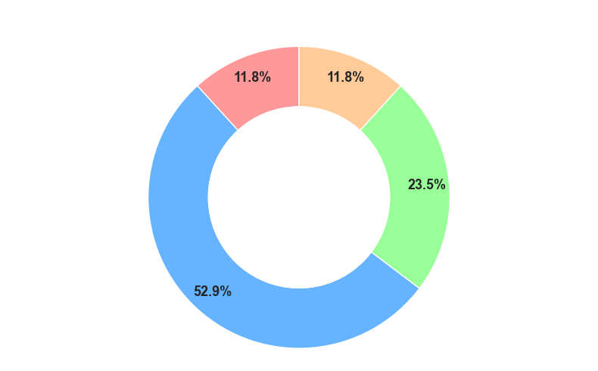
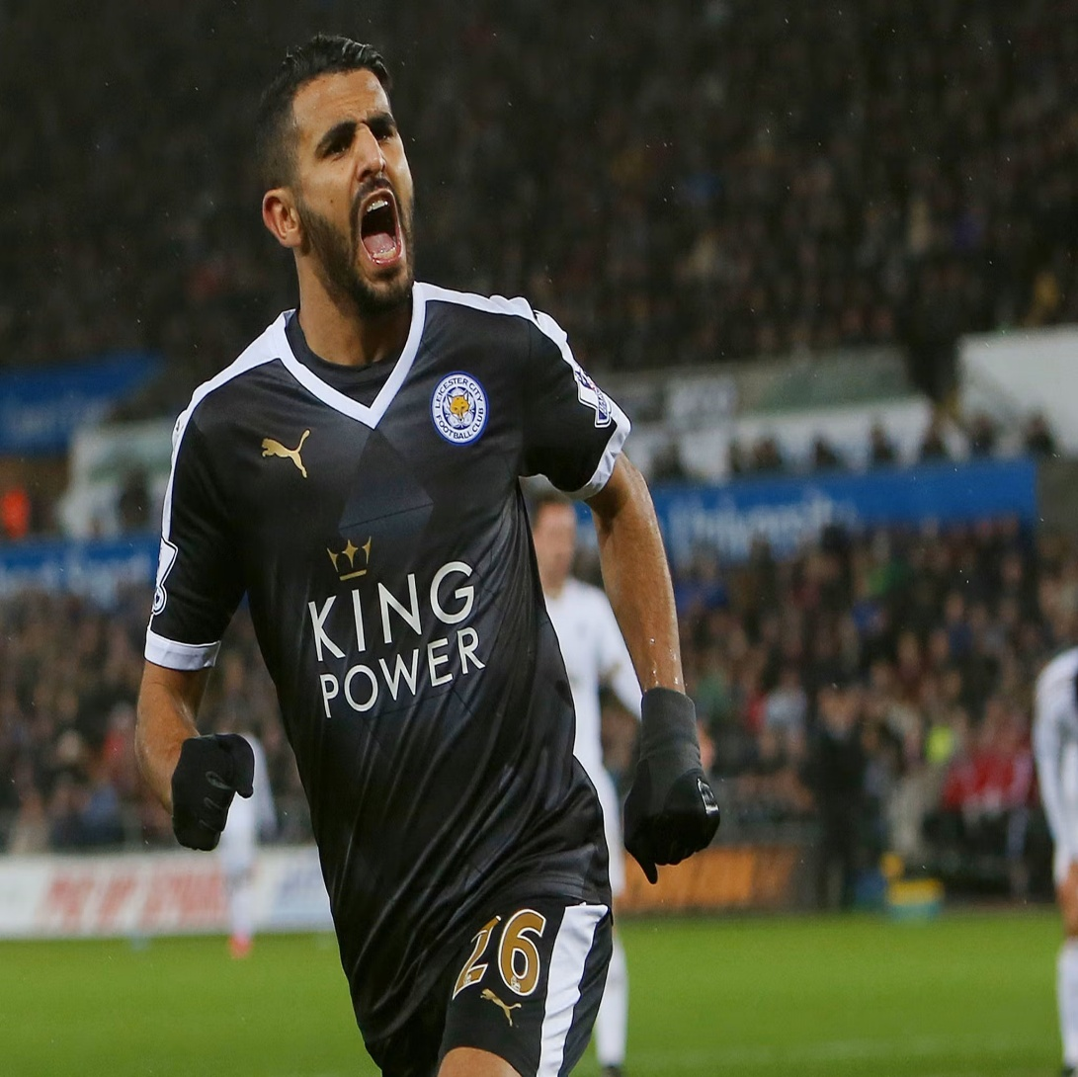
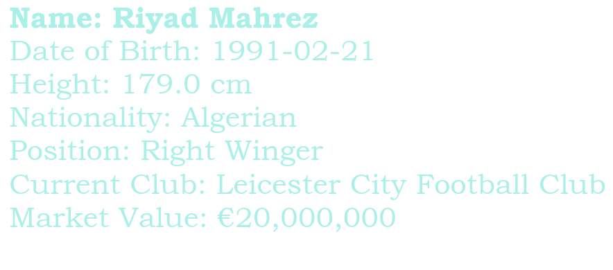
1. Classic Inverted Winger Profile: The data perfectly illustrates Mahrez's signature style. As a right-winger, he is heavily reliant on cutting inside to shoot with his dominant left foot (52.9% of goals). This is his primary method of scoring from open play.
2. Designated Penalty Taker: A significant portion of his goals (23.5%) come from penalties. This highlights his technical skill and composure under pressure, and confirms his status as a key, responsible player in his team.
3. Some Versatility: While he relies on his left foot, he also demonstrates an ability to score with his right foot and with headers, making him a more complete threat than a purely one-footed player.
Target 3

Slide 12
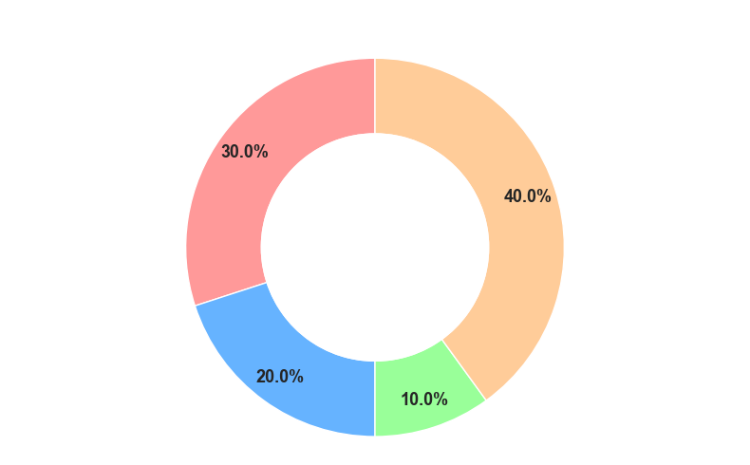
1. Effective Open-Play Creator: The chart shows that Mahrez is a strong and versatile playmaker during the run of play. The majority of his assists are created from open-play passes (40%) and crosses (20%).
2. Tactical Implications: This combination is highly valuable. His ability to create with passes shows he has the vision to combine with teammates in tight spaces. His ability to deliver crosses means he can also provide a threat from wide areas, keeping defenders guessing.
3. Set-Piece Contribution: He also contributes from free kicks, adding another dimension to his creative toolkit and proving he can be a threat in dead-ball situations.
Target 3

Slide 13
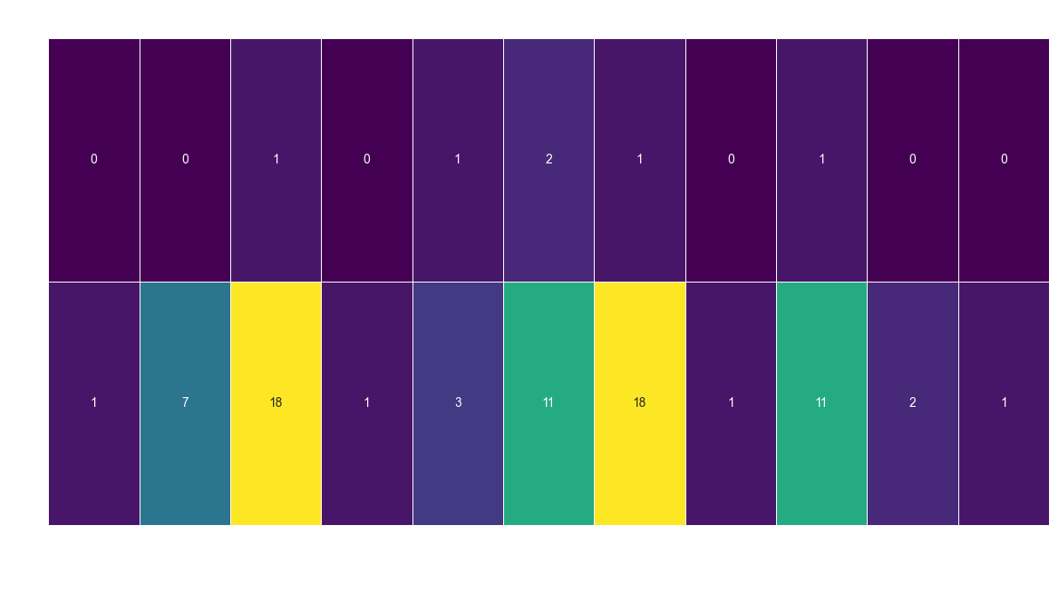
1. A True Specialist: The tactical data confirms that Mahrez is a specialist Right-Winger. Unlike other candidates, he has very limited experience in other attacking positions. His value comes from mastering one role to a world-class level.
2. Experience in Suitable Systems: He has extensive experience and has thrived in both the 4-2-3-1 and 4-4-2 formations. His success in the 4-2-3-1 system is a strong indicator that he could fit into our primary tactical setup without issues.
3. Less Flexible Profile: While he fits our primary formation, his lack of experience as a Left Winger or a central attacker makes him less flexible than other targets. He is the solution for the right-wing position, but not a player who can easily rotate across the entire front line.
Target 3

Slide 14
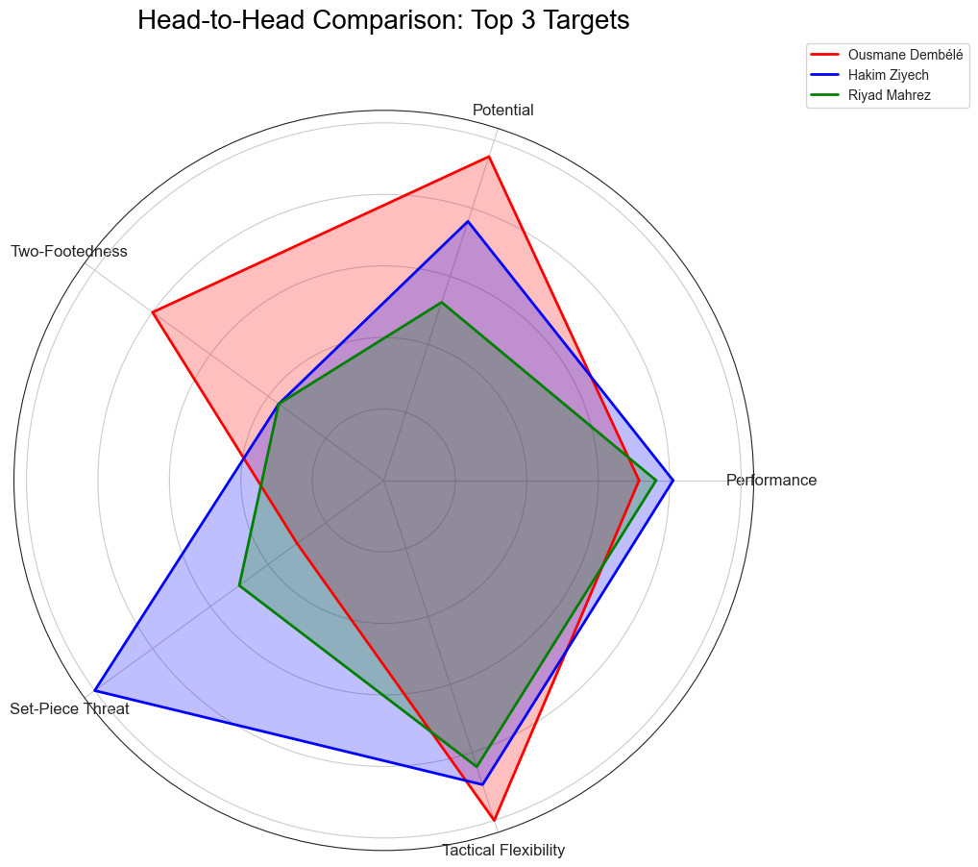
Final Comparision
Priority 1: Ousmane Dembélé
Strategic Rationale:
He is the optimal investment. Dembélé is the only candidate who scores at an elite level across nearly every critical attribute: performance, potential, and tactical fit. His rare two-footed ability makes him a unique and unpredictable weapon that perfectly aligns with Coach Tuchel's desire for a fluid, dynamic attack. He offers the highest potential reward and is a true strategic asset for the future.
Action:
Proceed with negotiations as the primary target.

Slide 15
Final Comparision
Priority 2: Hakim Ziyech
Strategic Rationale:
He is the best value-for-money, "guaranteed production" option. If the primary goal is to maximize immediate creative output, especially from set pieces, at the lowest cost, Ziyech is an outstanding choice. He is a high-level playmaker, though he offers less tactical flexibility than Dembélé.
Action:
Maintain active consideration as the top alternative.

Slide 16
Final Comparision
Priority 3: Riyad Mahrez
Strategic Rationale:
He is the "win-now," low-risk option. As the reigning Premier League Player of the Year, he guarantees world-class quality in his specialist position. However, he represents the highest cost, the lowest potential for growth, and the least tactical versatility, making him a less strategic fit for our long-term club philosophy compared to the other two candidates.
Action:
Monitor as a contingency option if other targets are unavailable.

Slide 17
THANK YOU

